Slide 1

SQL PROJECT
PIZZA SALES
By- Sujeet Kumar

Slide 2
SQL solves the challenge of efficiently managing and retrieving structured data in relational databases. Before SQL, data storage was unstructured and difficult to query. SQL enables quick data retrieval using commands like SELECT and JOIN, ensuring accuracy and consistency. It streamlines data management with INSERT, UPDATE, and DELETE while enforcing relationships through foreign keys. SQL also enhances security with access controls (GRANT, REVOKE). Additionally, it supports analytics and reporting using GROUP BY, HAVING, and ORDER BY, helping businesses derive insights and make informed decisions. SQL is essential for handling large-scale data operations across industries.

Slide 3
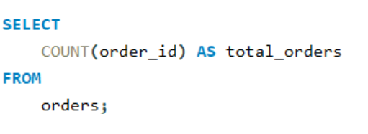

Retrieve the total number of orders placed

Slide 4
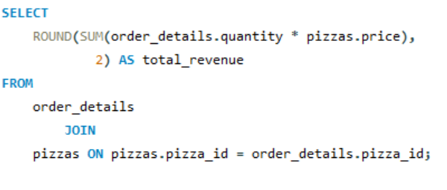

Calculate the total revenue generated from pizza sales

Slide 5
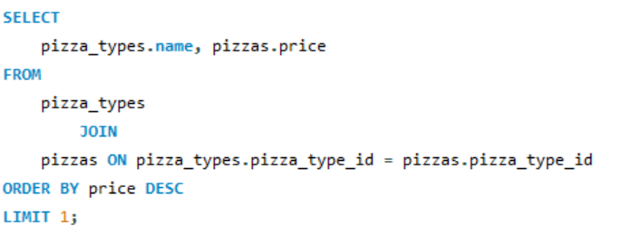

Identify the highest-priced pizza.

Slide 6
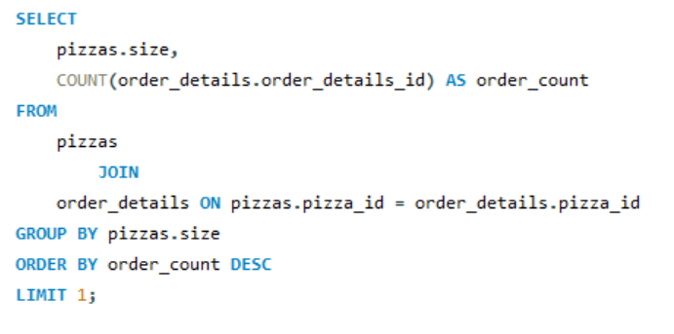

Identify the most common pizza size ordered.

Slide 7
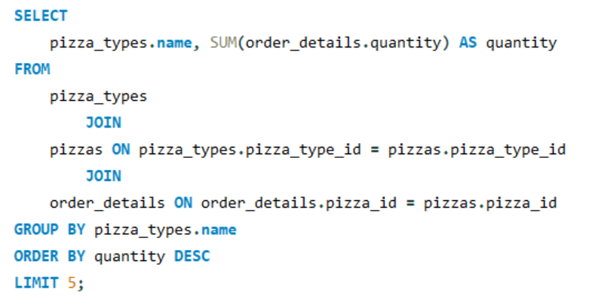
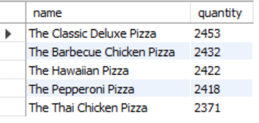
List the top 5 most ordered pizza types along with their quantities.

Slide 8
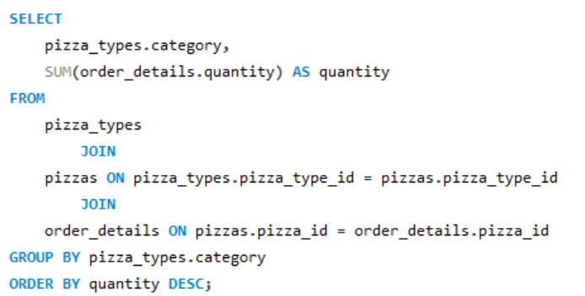
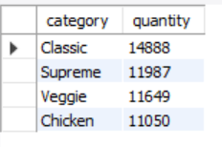
Join the necessary tables to find the total quantity of each pizza category ordered.

Slide 9
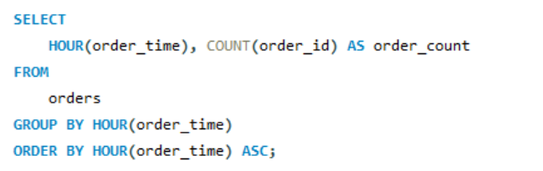
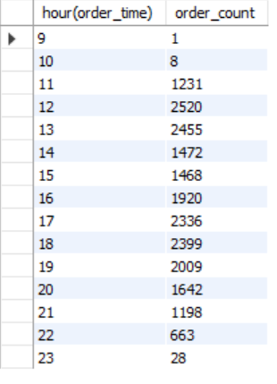
Determine the distribution of orders by hour of the day.

Slide 10
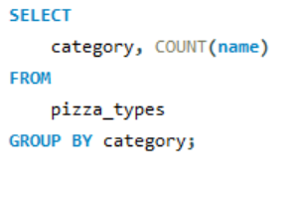
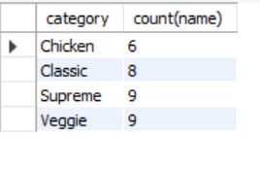
Join relevant tables to find the category-wise distribution of pizzas.

Slide 11
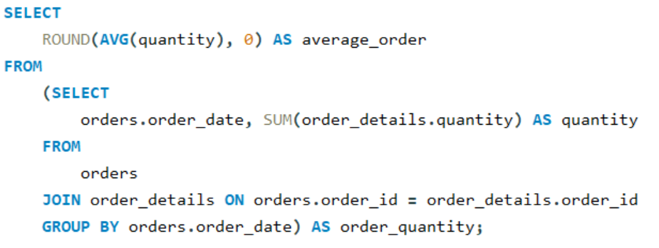

Group the orders by date and calculate the average number of pizzas ordered per day.

Slide 12
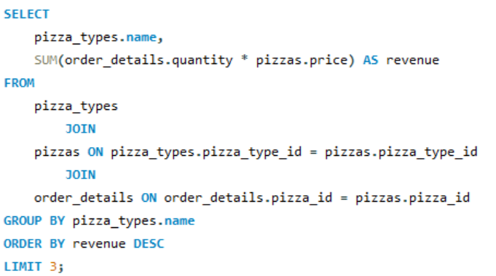
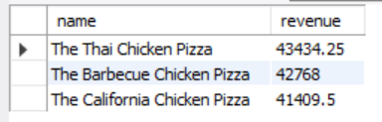
Determine the top 3 most ordered pizza types based on revenue.

Slide 13
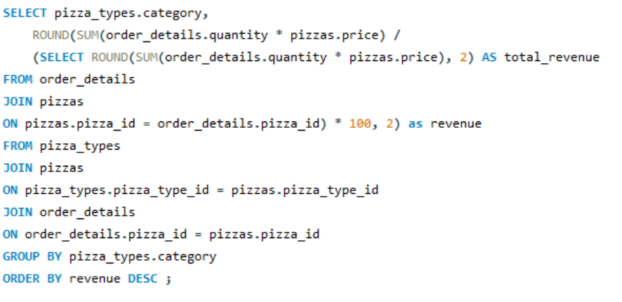
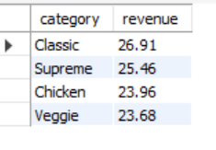
Calculate the percentage contribution of each pizza type to total revenue.

Slide 14
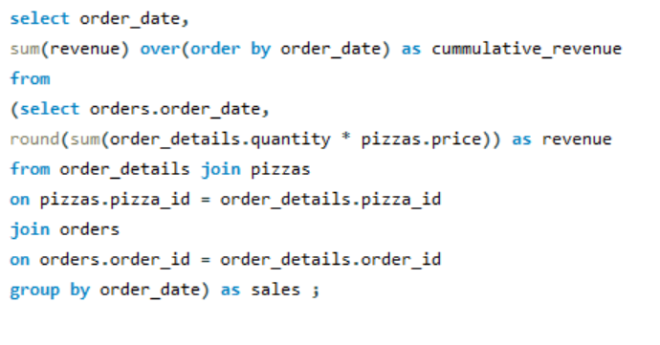
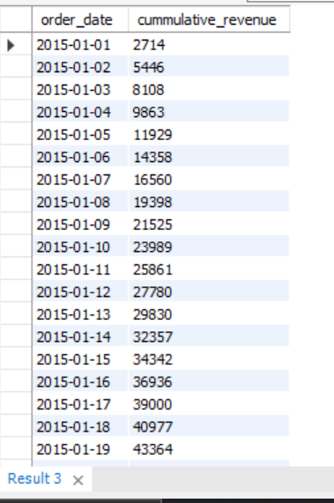
Analyze the cumulative revenue generated over time.

Slide 15
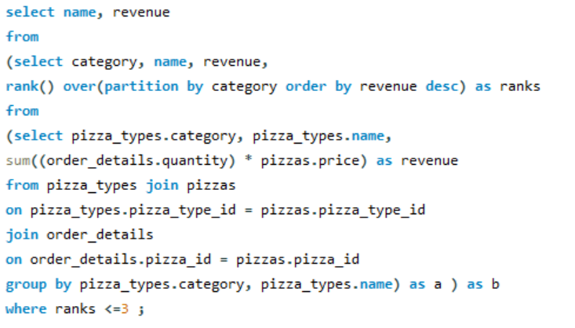
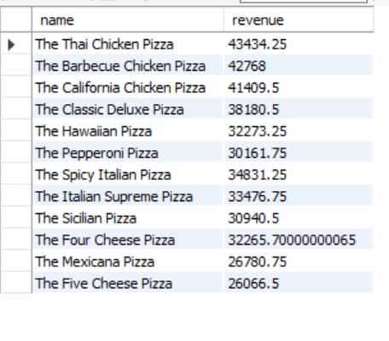
Determine the top 3 most ordered pizza types based on revenue for each pizza category.

Slide 16
Thank you

